Slide 1
Final Project Proposal
Team 4
b05902108 施承志
b05902036 夏瑜
b04502051 陳邦元
Notes:
We’re team 4, and people here are the team members.

Slide 2
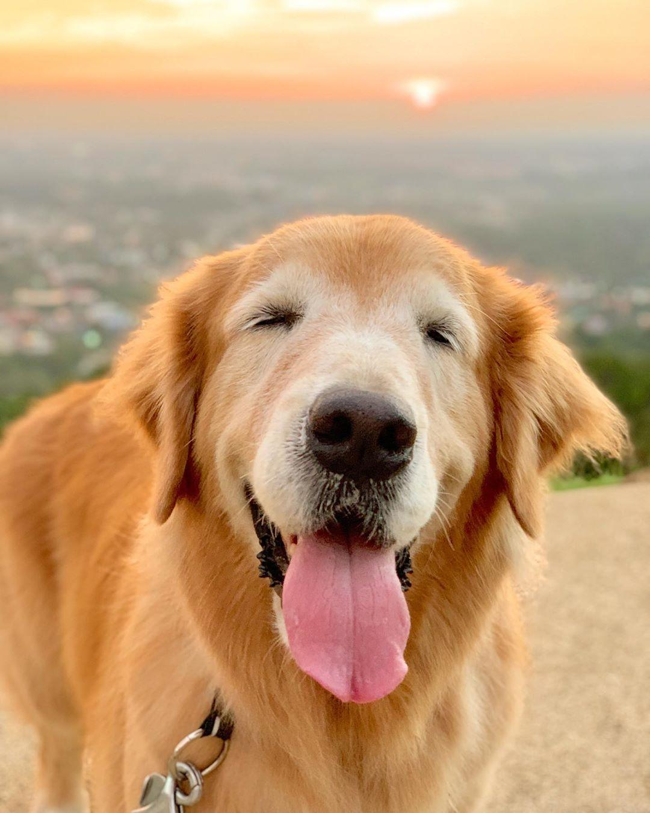

What
We’ll build an application on pioneer to achieve the followings:
Help people to find the target location they want to go
Guide people through the whole CS-building.
Proactively help people when they are in needs.
We call it CSIE-Retriever”.
Notes:
We’re going to build an application to help people find the target location they want to go.
For example, guide people through the CS-building. And we hope the pioneer also works in other environment.
Furthermore, we want the robot to proactively help people when they are in needs, maybe by identifying the person’s current conditions.
And we call it CSIE-Retriver.

Slide 3
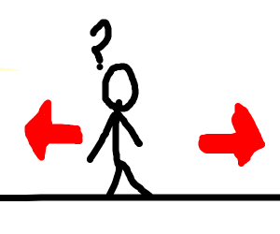
Why
Sometimes, some people want to visit CS-building but they don’t know where bathroom or elevator is. Additionally, lots of CS-students are too busy studying to help those people out. Therefore, with the aid of “CSIE-Retriever” , newcomers can immediately find the target and furthermore, have a thorough understanding of CS-building.
Notes:
Because new people come to CS-building not knowing where the elevator is, and most of the time, students here are too busy to help them, so we can build such application to help those people.

Slide 4
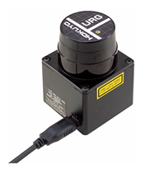
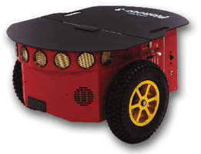
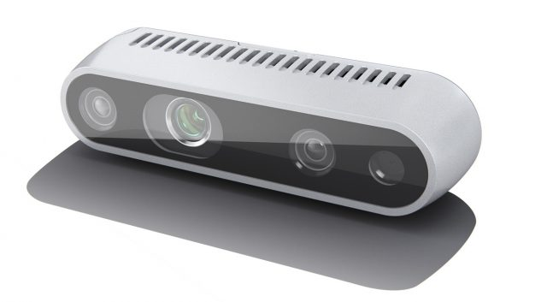
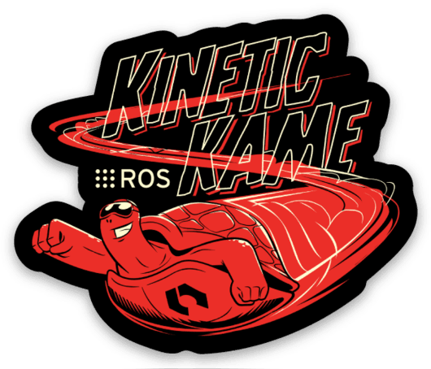

How
Hardware
Pioneer
Hokuyo URG-04LX-UG01
Realsense D435i
Software
ARIA Library
ROS
ROSARIA
p2os
slam-gmapping
...
Simulation
Gazebo
Notes:
The hardware here we plan to use are pioneer, some sensors, and cameras.
And the software are maybe ROS platform, using ROS, we can have lots of libraries to use, including aria, p2os, slam.
And we will also use Gazebo to construct the map to simulate the pioneer in virtual environment.

Slide 5
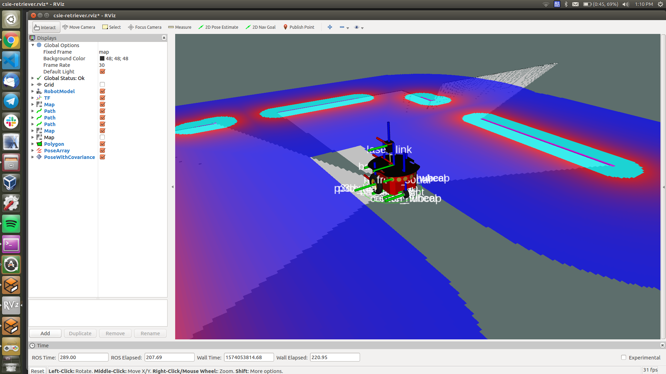
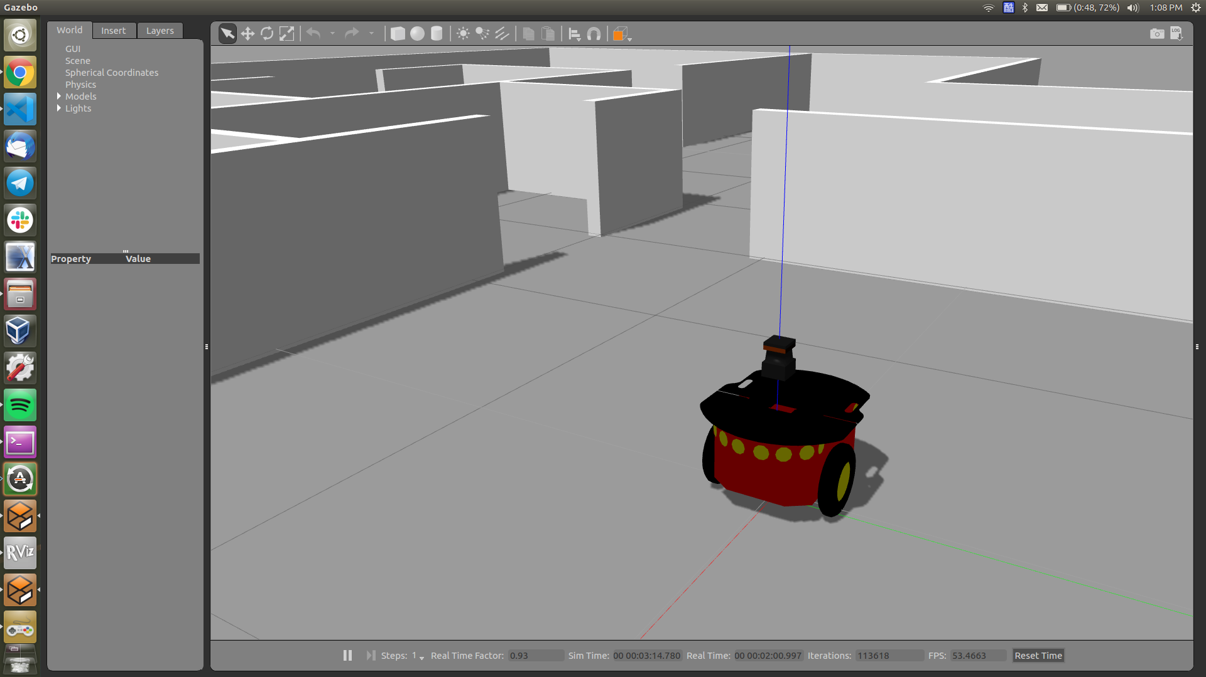
How
Notes:
So this is what it supposed to look like, use some already-exist 3D-model environment, put the pioneer in the environment and attach some sensors to the pioneer. And try to reconstruct the map

Slide 6
When (Schedule)
11/18 ~ 11/24 | setup environment for our pioneer (1)
11/25 ~ 12/1 | setup environment for our pioneer (2)
12/2 ~ 12/8 | reconstruct the map in our environment (1)
12/9 ~ 12/15 | reconstruct the map in our environment (2)
12/16 ~ 12/22 | plan on how to guide people through CS-building
12/23 ~ 12/29 | porting SR and NLP services on our pioneer
12/30 ~ 1/5 | refine our works
1/6 ~ 1/12 | add additional features
Notes:
And this is our schedule, we’ll spend two weeks setting up environment using Gazebo, spend 2 weeks reconstructing the map in that virtual environment, and spend one week on planning. During the time, we may book for pioneer, try it out and write some code on it.
After the basic planning is finished, we want the pioneer to guide the people base on what the person ask, so we’ll also spend one week, maybe use some SR, NLP package and port those packages on the pioneer.
And finally, we’ll refine our work and maybe add some additional features.
Additional feature including some object detection, face recognition, some computer vision thingies;
The schedule here maybe change in the future, but here is what we plan to do now.
(Additional features: facing toward the person asking, according to the person’s condition (boy or girl, etc) (using computer vision), give out different solutions)

Slide 7
Who
施承志：study topics mentioned, write codes
夏瑜：study topics mentioned, write codes
陳邦元 : study topics mentioned, write codes
Notes:
How we distribute our work is that everyone does everything.

Slide 8
Thanks
Notes:
That’s all thanks for listening

